Slide 1


毕业答辩 PPT模板
Huazhong University Of Science And Technology
答辩学生：研小招
指导老师：X X X

Slide 2
目 录
CONTENTS
1
选题的背景与意义
2
研究方法及过程
Background And Significance Of The Selected Topic
Research Methods And Processes
3
研究成果展示及其应用
4
论文总结
Research Results And Its Application
The Paper Summary

Slide 3
01
选题的背景与意义
BACKGROUND AND SIGNIFICANCE OF THE SELECTED TOPIC

Slide 4
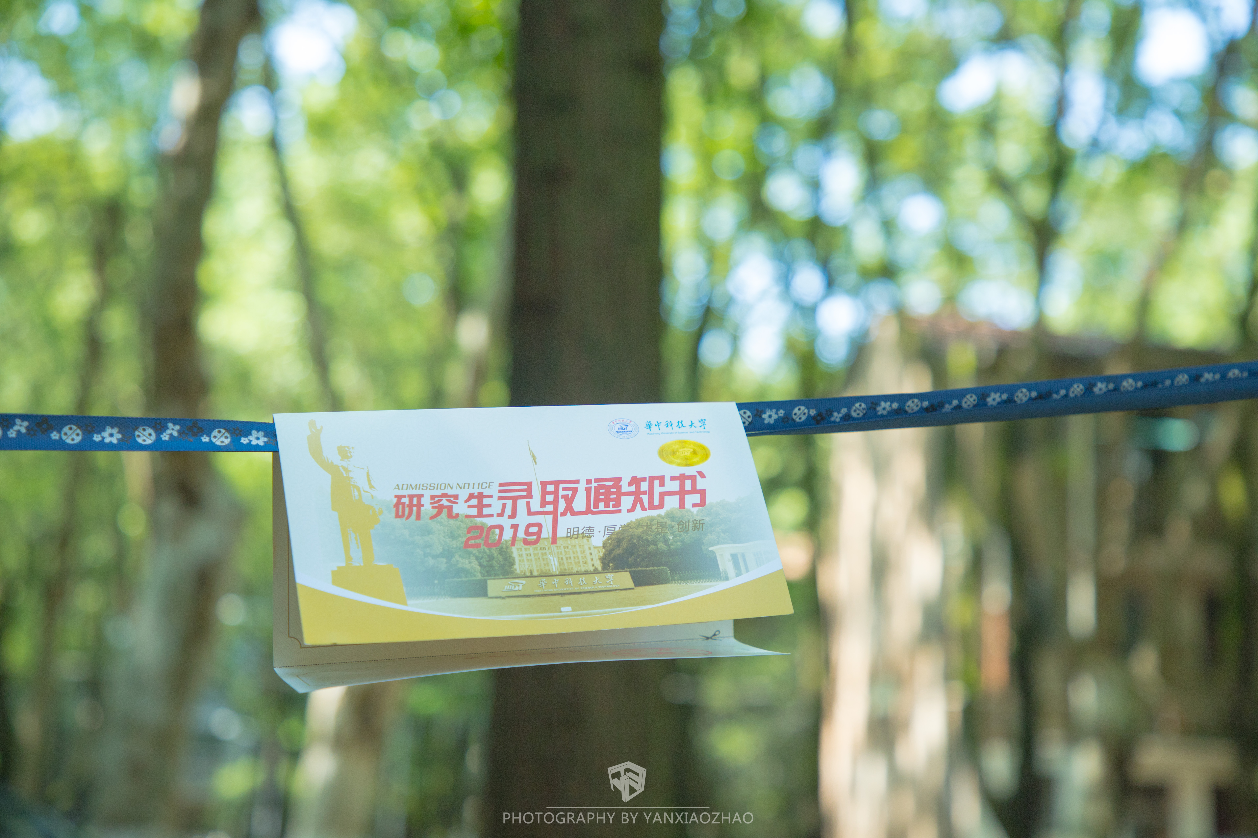
第一部分：选题的背景与意义
BACKGROUND AND SIGNIFICANCE OF THE SELECTED TOPIC
选题的背景
The campus covers an area of more than 7000 mu, with verdant trees, green grass, elegant environment, beautiful scenery and 72% green coverage. It is known as "Forest University". The school has a complete teaching and research support system and complete public service facilities.

Slide 5
第一部分：选题的背景与意义
BACKGROUND AND SIGNIFICANCE OF THE SELECTED TOPIC
选题的意义
选题的意义
The campus covers an area of more than 7000 mu, with verdant trees, green grass, elegant environment, beautiful scenery and 72% green coverage.
The campus covers an area of more than 7000 mu, with verdant trees, green grass, elegant environment, beautiful scenery and 72% green coverage.
选题的意义
选题的意义
The campus covers an area of more than 7000 mu, with verdant trees, green grass, elegant environment, beautiful scenery and 72% green coverage.
The campus covers an area of more than 7000 mu, with verdant trees, green grass, elegant environment, beautiful scenery and 72% green coverage.

Slide 6
第一部分：选题的背景与意义
BACKGROUND AND SIGNIFICANCE OF THE SELECTED TOPIC
国内研究现状
国外研究现状
The campus covers an area of more than 7000 mu, with verdant trees, green grass, elegant environment, beautiful scenery and 72% green coverage.
The campus covers an area of more than 7000 mu, with verdant trees, green grass, elegant environment, beautiful scenery and 72% green coverage.

Slide 7
02
研究方法及过程
RESEARCH METHODS AND PROCESSES

Slide 8
第二部分：研究方法及过程
RESEARCH METHODS AND PROCESSES
研究方法
研究方法
研究方法
研究方法
The campus covers an area of more than 7000 mu, with verdant trees, green grass, elegant environment
The campus covers an area of more than 7000 mu, with verdant trees, green grass, elegant environment
The campus covers an area of more than 7000 mu, with verdant trees, green grass, elegant environment
The campus covers an area of more than 7000 mu, with verdant trees, green grass, elegant environment

Slide 9
第二部分：研究方法及过程
RESEARCH METHODS AND PROCESSES
课题研究
The campus covers an area of more than 7000 mu, with verdant trees, green grass, elegant environment
实验论证
The campus covers an area of more than 7000 mu, with verdant trees, green grass, elegant environment
检查调整
The campus covers an area of more than 7000 mu, with verdant trees, green grass, elegant environment
撰写论文
The campus covers an area of more than 7000 mu, with verdant trees, green grass, elegant environment

Slide 10
03
研究成果展示及其应用
RESEARCH RESULTS AND ITS APPLICATION

Slide 11
第三部分：研究成果展示及其应用
RESEARCH RESULTS AND ITS APPLICATION
01
研究成果应用
The campus covers an area of more than 7000 mu, with verdant trees, green grass, elegant environment, beautiful scenery and 72% green coverage.
02
研究成果应用
The campus covers an area of more than 7000 mu, with verdant trees, green grass, elegant environment, beautiful scenery and 72% green coverage.
03
研究成果应用
The campus covers an area of more than 7000 mu, with verdant trees, green grass, elegant environment, beautiful scenery and 72% green coverage.

Slide 12
04
论文总结与致谢
THE SUMMARY AND ACKNOWLEDGMENT

Slide 13
第四部分：论文总结与致谢
THE SUMMARY AND ACKNOWLEDGMENT
创新点
The campus covers an area of more than 7000 mu, with verdant trees, green grass, elegant environment, beautiful scenery and 72% green coverage.
The campus covers an area of more than 7000 mu, with verdant trees, green grass, elegant environment, beautiful scenery and 72% green coverage.
不足之处
The campus covers an area of more than 7000 mu, with verdant trees, green grass, elegant environment, beautiful scenery and 72% green coverage.
The campus covers an area of more than 7000 mu, with verdant trees, green grass, elegant environment, beautiful scenery and 72% green coverage.

Slide 14
第四部分：论文总结与致谢
THE SUMMARY AND ACKNOWLEDGMENT
论文总结
论文总结
The campus covers an area of more than 7000 mu, with verdant trees, green grass, elegant environment, beautiful scenery and 72% green coverage.
The campus covers an area of more than 7000 mu, with verdant trees, green grass, elegant environment, beautiful scenery and 72% green coverage.
论文总结
论文总结
The campus covers an area of more than 7000 mu, with verdant trees, green grass, elegant environment, beautiful scenery and 72% green coverage.
The campus covers an area of more than 7000 mu, with verdant trees, green grass, elegant environment, beautiful scenery and 72% green coverage.

Slide 15
感谢各位专家批评指正
THANK YOU FOR WATCHING
答辩学生：研小招
指导老师：XXX
XXXXXX 学院 XXXX班

